Slide 2
.NET DevOps
Martin Woodward
@Martin Woodward

Slide 3



Martin Woodward
@Martin Woodward
https://azure.com/devops
#AzureDevOps
Notes:
Join the conversation.
Potentially replace for speaker contact details / intro.

Slide 4
What is DevOps?
People. Process. Products.
Build& Test
Deploy
DevOps is the union of people, process, and products to enable continuous delivery of value to your end users.
“
Continuous Delivery
Develop
Operate
”
Plan & Track
Monitor & Learn
Notes:
DevOps is the union of people, process and products to enable the continuous delivery of value to your end customers

Slide 5


High Performance DevOps Companies Achieve…
46x Deployment
Frequency
2,555x Faster Lead
Time For Changes
Faster
Time to Market
DevOps
$
Increased
Revenue
7x Lower Change
Failure Rate
2,604x Faster Mean
Time to Recover
Source: 2018 Accelerate: State of DevOps: Strategies for a New Economy." N. Forsgren, J. Humble, G. Kim. DevOps Research and Assessment (DORA)

Slide 6
What core technologies do I need to deploy & learn faster?
DevOps brings together people, processes, and technology, automating software delivery to provide continuous value to your users. Using Azure DevOps, you can deliver software faster and more reliably - no matter how big your IT department or what tools you’re using.
Continuous Integration (CI)
Improve software development quality and speed.
When you use Azure Pipelines or Jenkins to build apps in the cloud and deploy to Azure, each time you commit code, it’s automatically built and tested and bugs are detected faster.
Continuous Deployment (CD)
By combining continuous integration and infrastructure as code (IaC), you’ll achieve identical deployments and the confidence to deploy to production at any time.
With continuous deployment, you can automate the entire process from code commit to production if your CI/CD tests are successful.
Continuous Learning & Monitoring
With Azure Application Insights you can identify how your applications are performing and test if the recent deployment made things better or worse.
Using CI/CD practices, paired with monitoring tools, you’ll be able to safely deliver features to your customers as soon as they’re ready.

Slide 7





Introducing Azure DevOps
Azure Boards
Azure Pipelines
Azure Repos
Deliver value to your users faster using proven agile tools to plan, track, and discuss work across your teams.
Build, test, and deploy with CI/CD that works with any language, platform, and cloud. Connect to GitHub or any other Git provider and deploy continuously.
Get unlimited, cloud-hosted private Git repos and collaborate to build better code with pull requests and advanced file management.
Azure Test Plans
Azure Artifacts
➔
Test and ship with confidence using manual and exploratory testing tools.
Create, host, and share packages with your team, and add artifacts to your CI/CD pipelines with a single click.
https://azure.com/devops
Notes:
So does TFS

Slide 8

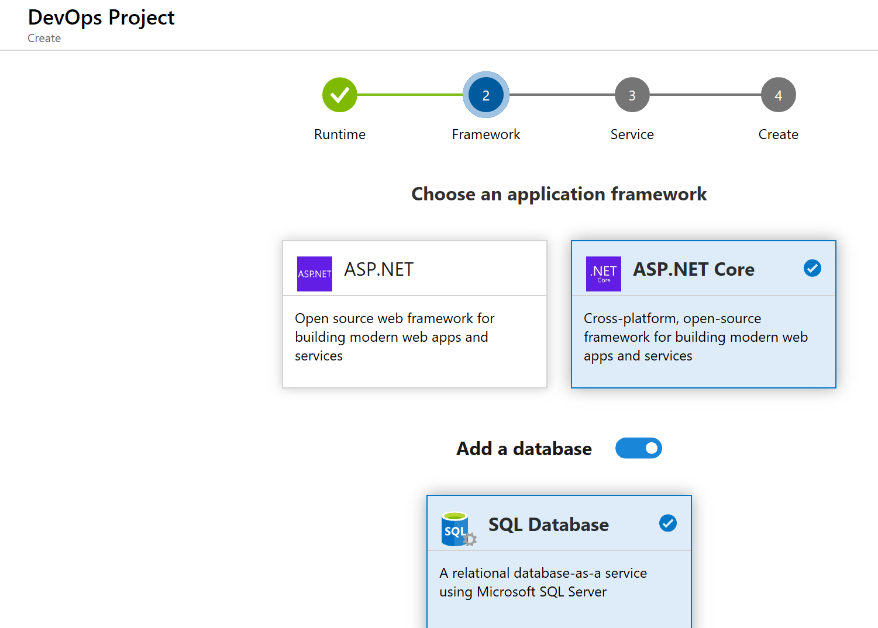
DevOps Pipelines in Minutes
Azure DevOps Projects
Create a full ASP.NET DevOps pipeline with 4 easy steps from the Azure Portal
Start with a Git repo, web app and pre-configured pipeline
Customize, extend and scale when needed.
Notes:
Moving from the developer environment, Azure also makes deploying, or integrating existing, DevOps pipelines as fast as possible
Azure DevOps Projects is the quickest way to get started with DevOps on Azure for people who know about DevOps but are just starting or want a quick way to create a basic pipeline to play with or build upon.
DevOps projects creates a basic, complete CI/CD pipeline in Azure which can later be extended and customized outside in Azure Pipelines
Although DevOps Projects builds a DevOps pipeline on Azure it allows for any easy “Getting started” experience with Azure Pipelines which can then be applied to hybrid and on-prem scenarios with Azure Pipelines which can target any platform or with Azure DevOps Server which can be installed on prem.

Slide 9
Demo Azure DevOps Projects

Slide 10
Iteratively Removing Impediments
Build& Test
Deploy
Find the pain points in your DevOps processes and improve a bit, reassess and improve again.
Lots of small incremental improvements add up.
Continuous Delivery
Develop
Operate
Plan & Track
Monitor & Learn
Notes:
DevOps is the union of people, process and products to enable the continuous delivery of value to your end customers

Slide 11
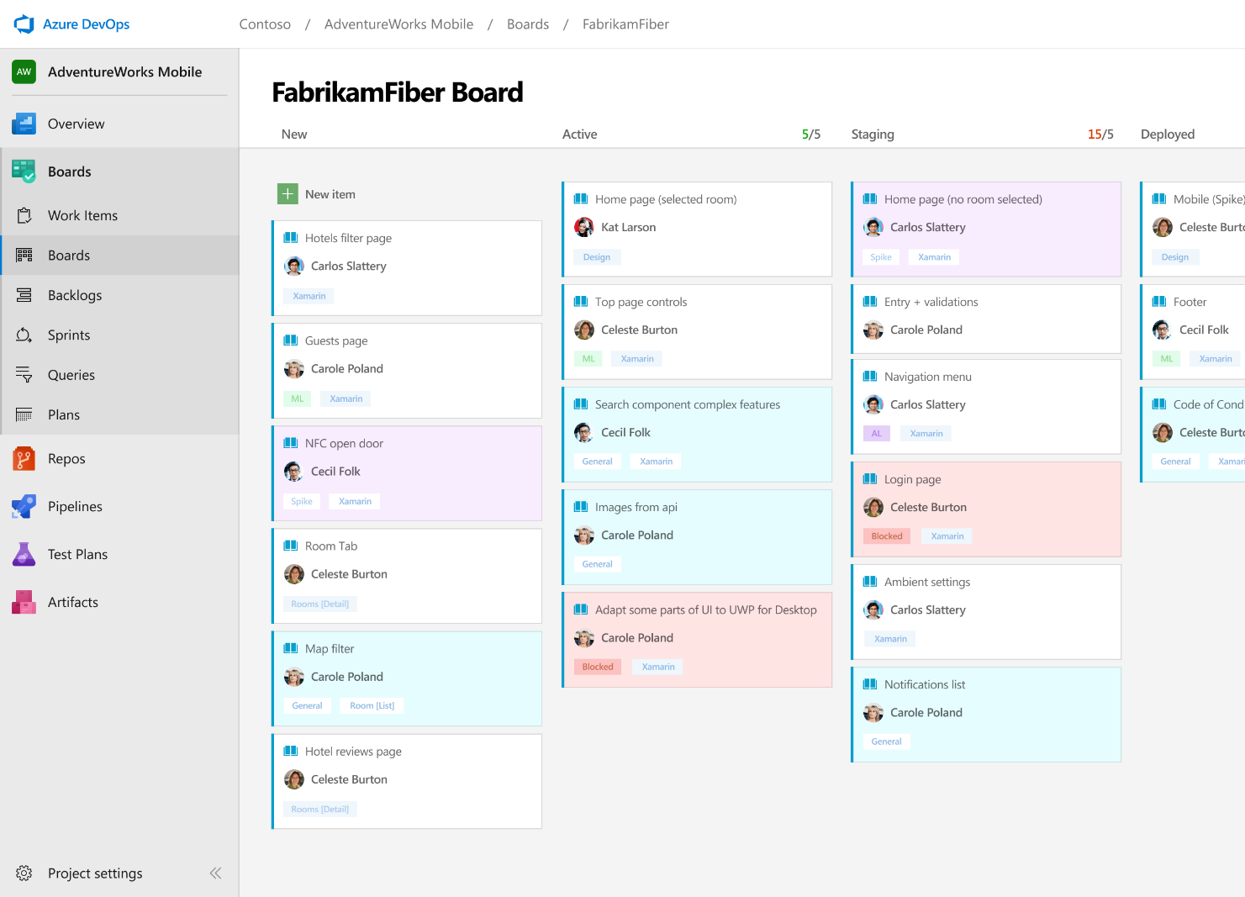



Azure Boards
Track work with Kanban boards, backlogs, team dashboards, and custom reporting
Connected from idea to release
Track all your ideas at every development stage and keep your team aligned with all code changes linked directly to work items.
Scrum ready
Use built-in scrum boards and planning tools to help your teams run sprints, stand-ups, and planning meetings.
Project insights
Gain new insights into the health and status of your project with powerful analytics tools and dashboard widgets.
➔
https://azure.com/devops
Notes:
Combine Kanban boards and drag-and-drop sprint planning with comprehensive traceability and reporting for the perfect home for all your ideas–big and small.

Slide 12
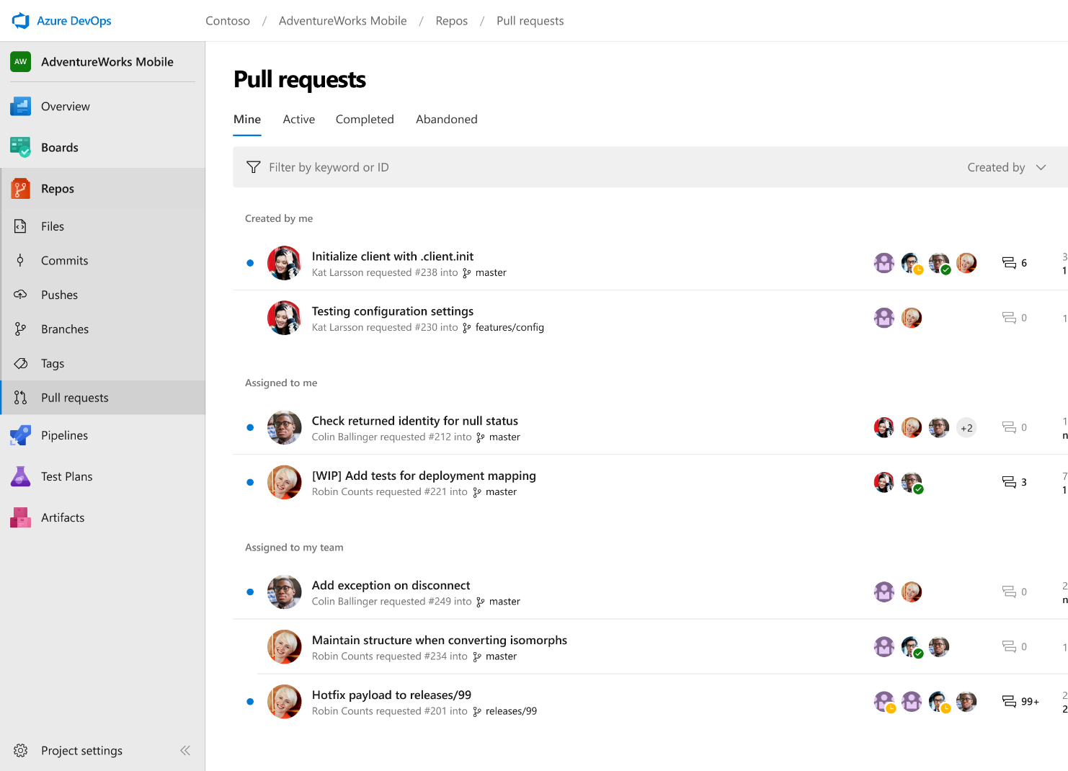



Azure Repos
Unlimited private Git repo hosting and support for TFVC that scales from a hobby project to the world’s largest Git repositories
Works with your Git client
Securely connect with and push code into your Git repos from any IDE, editor, or Git client.
Web hooks and API integration
Add validations and extensions from the marketplace or build your own using web hooks and REST APIs.
Semantic code search
Quickly find what you’re looking for with code-aware search that understands classes and variables.
➔
https://azure.com/devops
Notes:
Collaborate on code changes with threaded discussion and continuous integration for each change. Use forks to promote collaboration with Inner Source workflows.

Slide 13

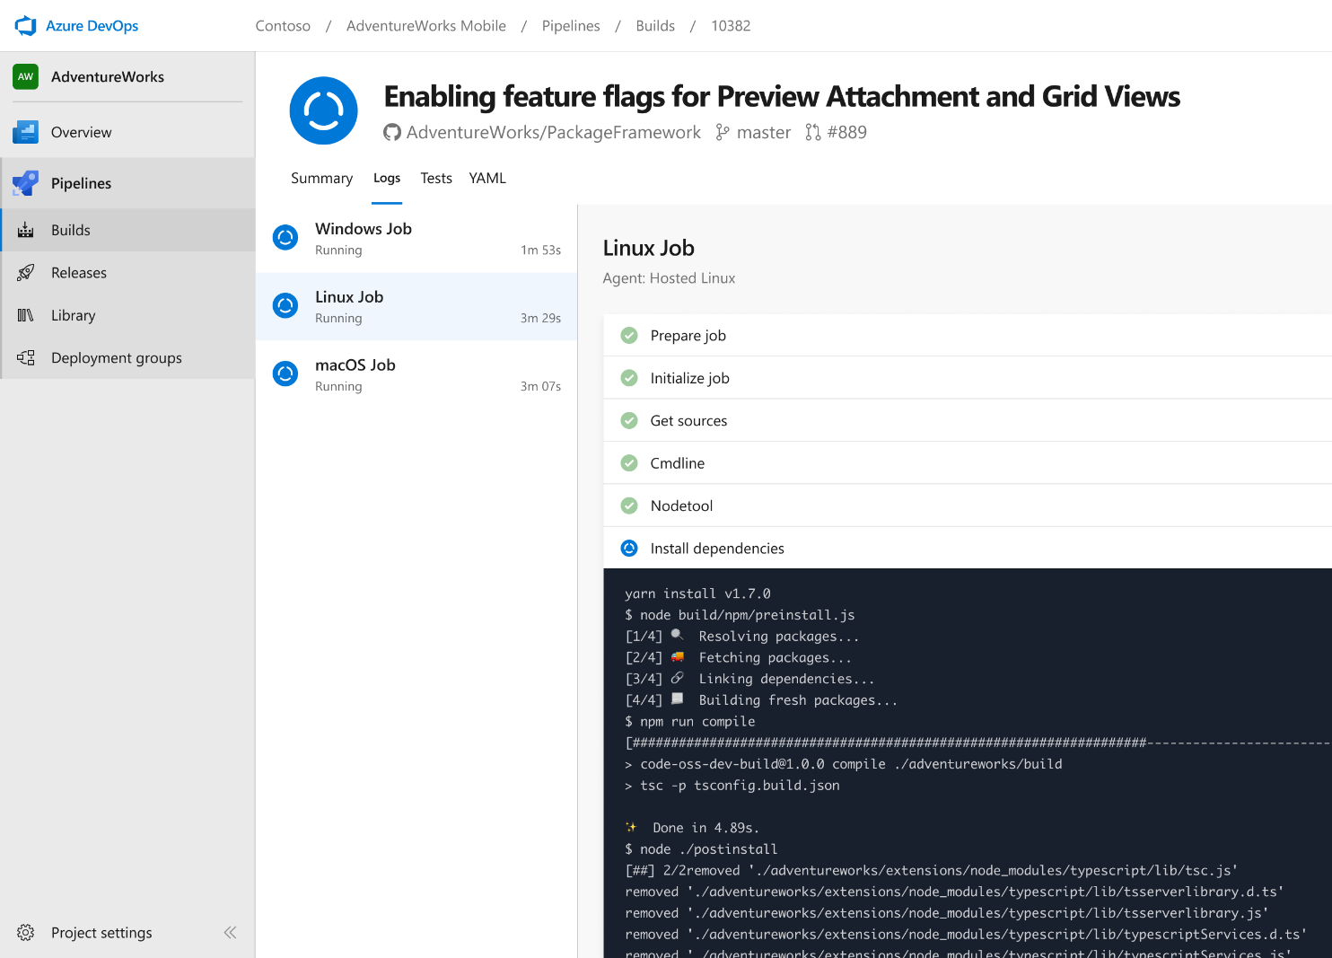


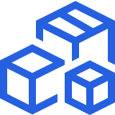

Azure Pipelines
Cloud-hosted pipelines for Linux, Windows and macOS, with unlimited minutes for open source
Any language, any platform, any cloud
Build, test, and deploy Node.js, Python, Java, PHP, Ruby, C/C++, .NET, Android, and iOS apps. Run in parallel on Linux, macOS, and Windows. Deploy to Azure, AWS, GCP or on-premises
Extensible
Explore and implement a wide range of community-built build, test, and deployment tasks, along with hundreds of extensions from Slack to SonarCloud. Support for YAML, reporting and more
Containers and Kubernetes
Easily build and push images to container registries like Docker Hub and Azure Container Registry. Deploy containers to individual hosts or Kubernetes.
Best-in-class for open source
Ensure fast continuous integration/continuous delivery (CI/CD) pipelines for every open source project. Get unlimited build minutes for all open source projects with up to 10 free parallel jobs across Linux, macOS and Windows
➔
https://azure.com/pipelines
Notes:
Azure Pipelines is the perfect launchpad for your code – automating your builds and deployments so you spend less time with the nuts and bolts and more time being creative

Slide 14


Azure Pipelines
Microsoft Open Source
Free unlimited build minutes for public projects
Up to 10 free parallel jobs across Windows, Linux and macOS
➔
https://azure.com/pipelines
Notes:
All the builds you need, using the power of Azure you get one service that gives you unlimited build minutes where you can build on Windows Mac and Linux in parallel using a single build YAML file.

Slide 15

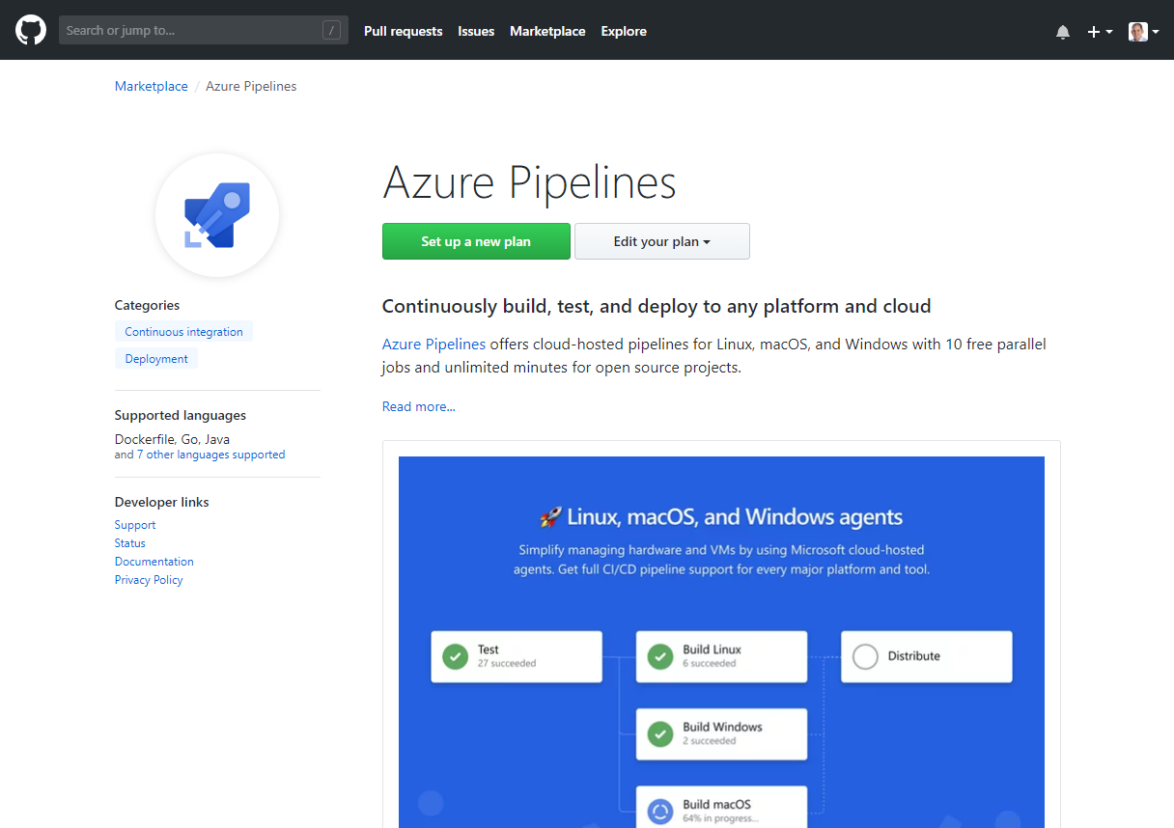
Integrated with GitHub
Azure Pipelines available now to any developer from the GitHub Marketplace

Slide 16

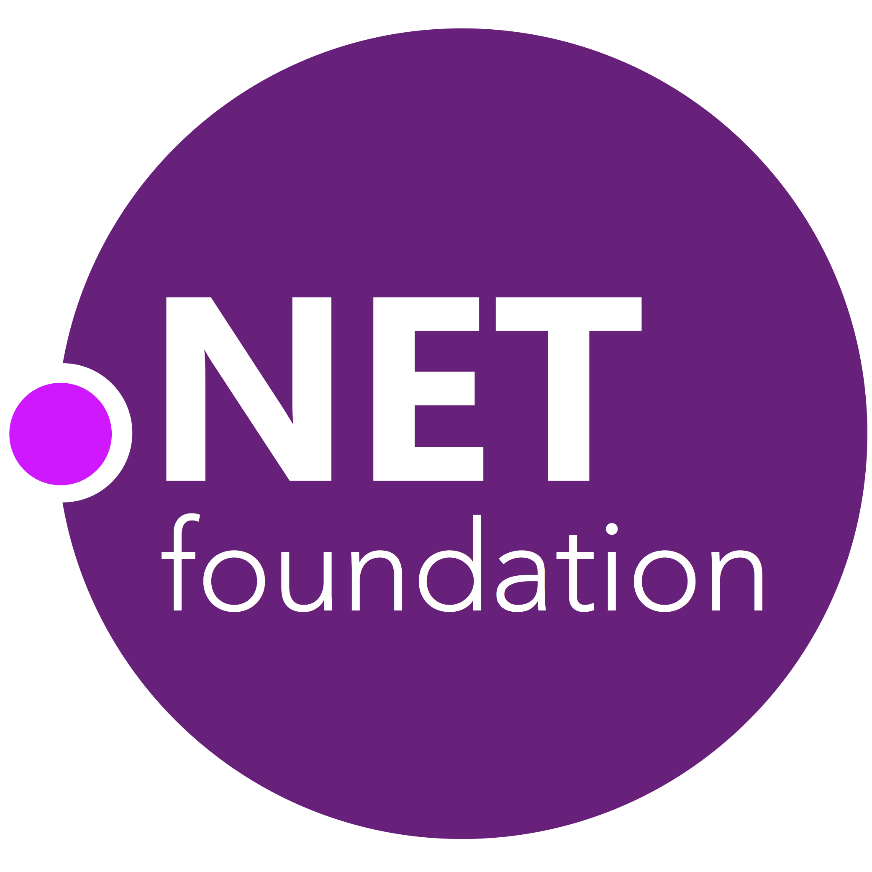
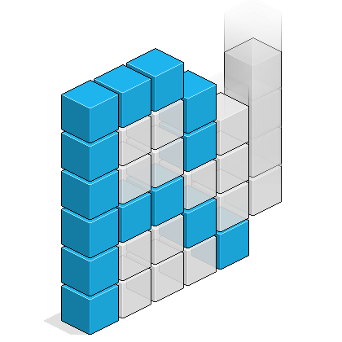


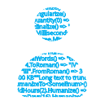

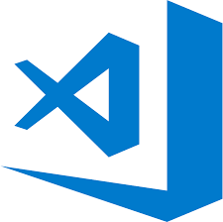
Early adopters
GitHub projects already powered by Azure Pipelines for CI
Notes:
.NET Foundation
Reactive UI
Reactive Extensions
Cake Build
NuGet Package Explorer
Humanizer
VS Code

Slide 17
Demo Open Source Powered by Azure Pipelines

Slide 18

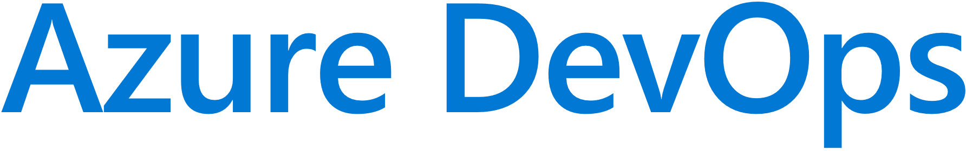
Self-Hosted Agents
Ideal if you require custom build pre-requisites, control vendor license keys etc
Can create in cloud or on-prem
Can also deploy to on-prem servers from Azure DevOps
Can use deployment groups to dynamically provision to target deployment group types
Default
Hosted
Microsoft Hosted Agents
Self-Hosted Agents
Target on-premises environment
© Microsoft Corporation

Slide 19

DevOps for Desktop
DevOps principles are not just for web apps, containers & micro-service architectures. Common area of focus is on improving the flow of value to your customers with CI & CD to the desktop
Evergreen Installation Technologies
ClickOnce
Squirrel
Microsoft Store for Business and Education
Notes:
Private store in Microsoft Store for Business and Education.
Only Windows 10
Can work with WinForms / WPF apps using Desktop Bridge
Can use in combination with inTune for managed devices.

Slide 20
Demo Desktop DevOps

Slide 21
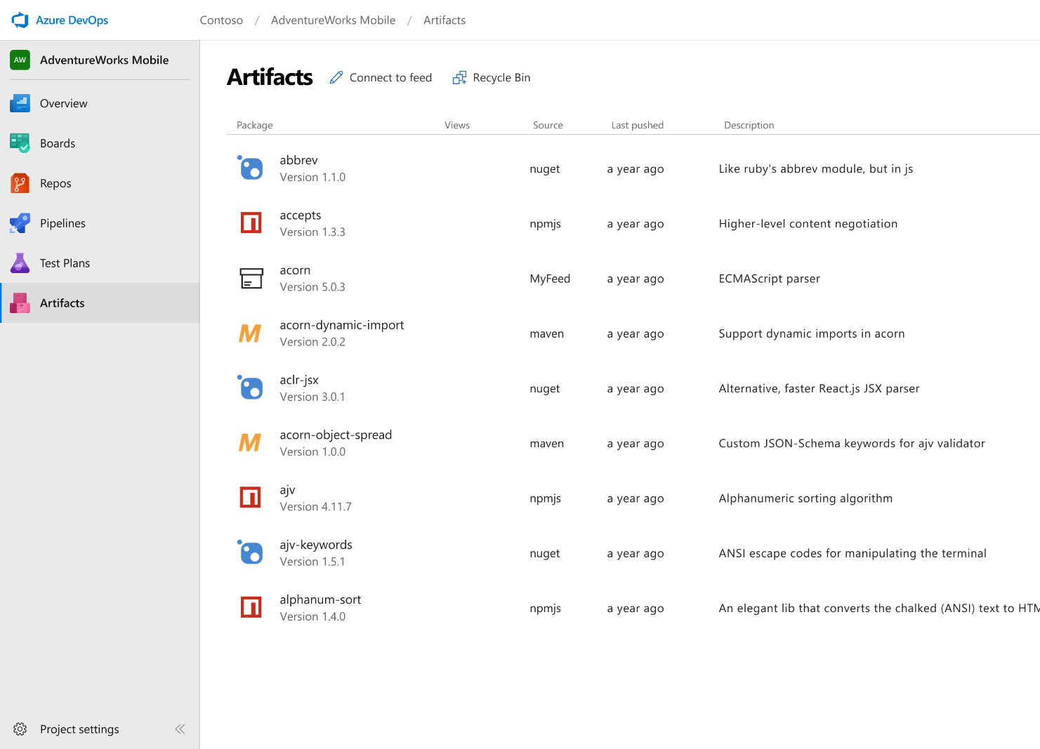



Azure Artifacts
Create and share Maven, npm, and NuGet package feeds from public and private sources – fully integrated into CI/CD pipelines
Manage all package types
Get universal artifact management for Maven, npm, and NuGet.
Add packages to any pipeline
Share packages, and use built-in CI/CD, versioning, and testing.
Share code efficiently
Easily share code across small teams and large enterprises.
➔
https://azure.com/devops
Notes:
Collaborate on code changes with threaded discussion and continuous integration for each change. Use forks to promote collaboration with Inner Source workflows.

Slide 22
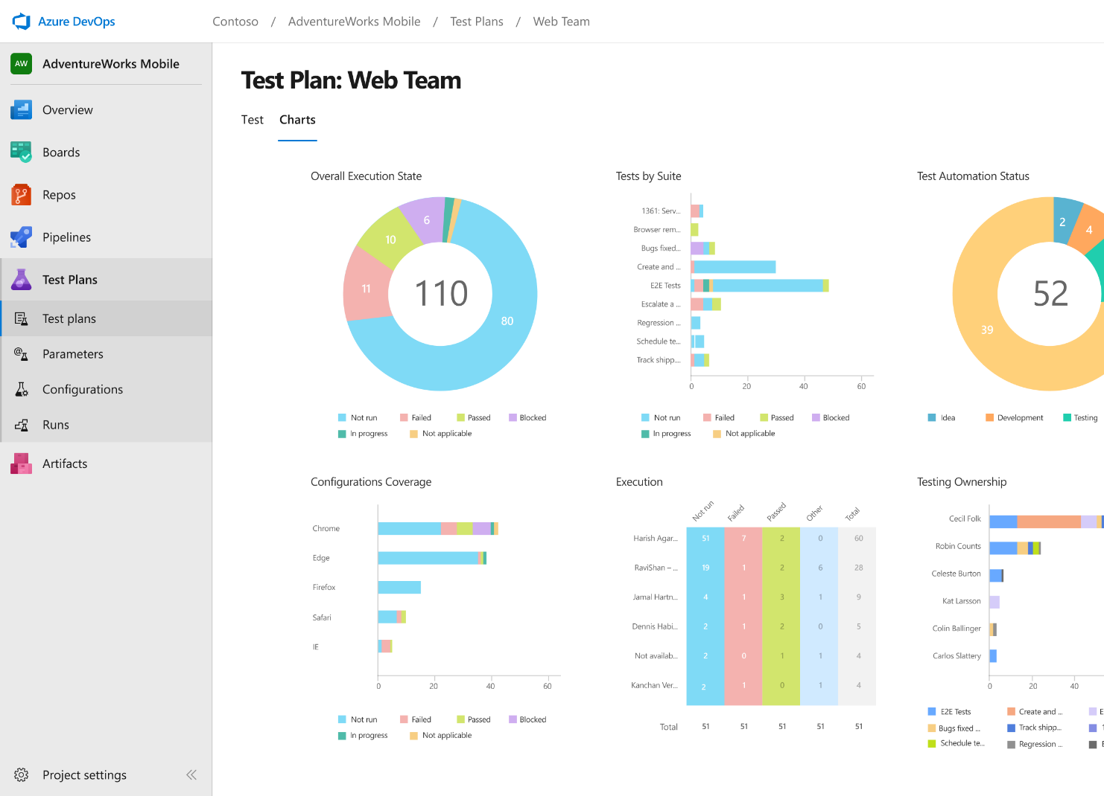
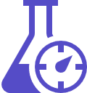


Azure Test Plans
Get end-to-end traceability. Run tests and log defects from your browser. Track and assess quality throughout your testing lifecycle.
Capture rich data
Capture rich scenario data as you execute tests to make discovered defects actionable. Explore user stories without test cases or test steps. You can create test cases directly from your exploratory test sessions.
Test across web and desktop
Test your application where it lives. Complete scripted tests across desktop or web scenarios. Test on-premises application from the cloud and vice-versa.
Get end-to-end traceability
Leverage the same test tools across your engineers and user acceptance testing stakeholders. Pay for the tools only when you need them.
➔
https://azure.com/devops
Notes:
Collaborate on code changes with threaded discussion and continuous integration for each change. Use forks to promote collaboration with Inner Source workflows.

Slide 23

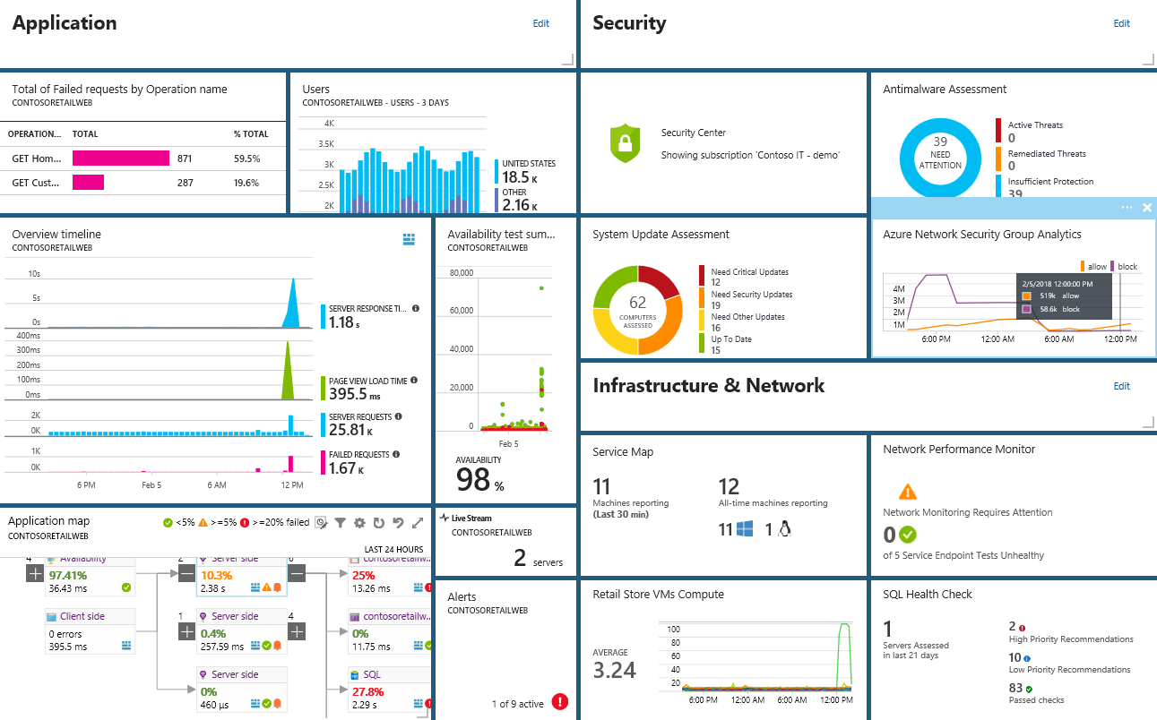
Smarter Insights, Faster
Azure Monitor, Security Center, Application Insights & Log Analytics
Pre-defined solutions with smart thresholds
Visualize data in intuitive and customizable dashboards
Separate the signal from the noise and accelerate root-cause analysis
Integrate your existing processes & tools like Service Now
Notes:
Azure’s monitoring solutions provide pre-defined solutions with smart thresholds and intuitive dashboards so you can start getting insights straight away
Azure Monitor provides metrics for all Azure infrastructure, building upon that you can leverage both Log Analytics and Application Insights to gain greater insights into your Infrastructure and Applications respectively – leveraging Azure to simplify this into standardized dashboards for both your Developer and your Operations teams
Spend less time separating the signal from the noise and accelerate you root cause analysis
You can also automate and integrate into your existing service desk platforms such as Service Now
------ (additional product context) ------
Monitor your cloud health with Log Analytics
Collect and store your data from any source
Easily collect, store, and analyze your systems and operational data from any source, both on-premises and in the cloud.
Collect data from a wide range of sources including virtual machines, storage accounts, activity logs, Windows, Linux Servers, Java, .NET, legacy and modern apps.
Centrally store activity logs, network logs, infrastructure metrics, app data points, diagnostics logs and alerts.
Gain deep operational insights
Understand CPU disk and memory utilization for your virtual machines.
Get a comprehensive view of applications and network dependencies across multiple virtual machines to perform root-cause analysis more quickly.
Track configuration changes, system updates, and malware status to improve security & compliance.
Visualize data in intuitive and customizable dashboards.
Find the information you need quickly using interactive queries and full-text search.
Detect, diagnose and fix issues quickly
Get notifications and alerts with rich diagnostic information so you can always stay on top of the issues.
Separate the signal from the noise and accelerate root-cause analysis across platforms using advanced analytics including machine learning algorithms.
Automate the implementation of recommended fixes so you can address issues quickly.
Integrate with customer service systems such as your ticketing tool to speed up implementation of fixes.

Slide 24
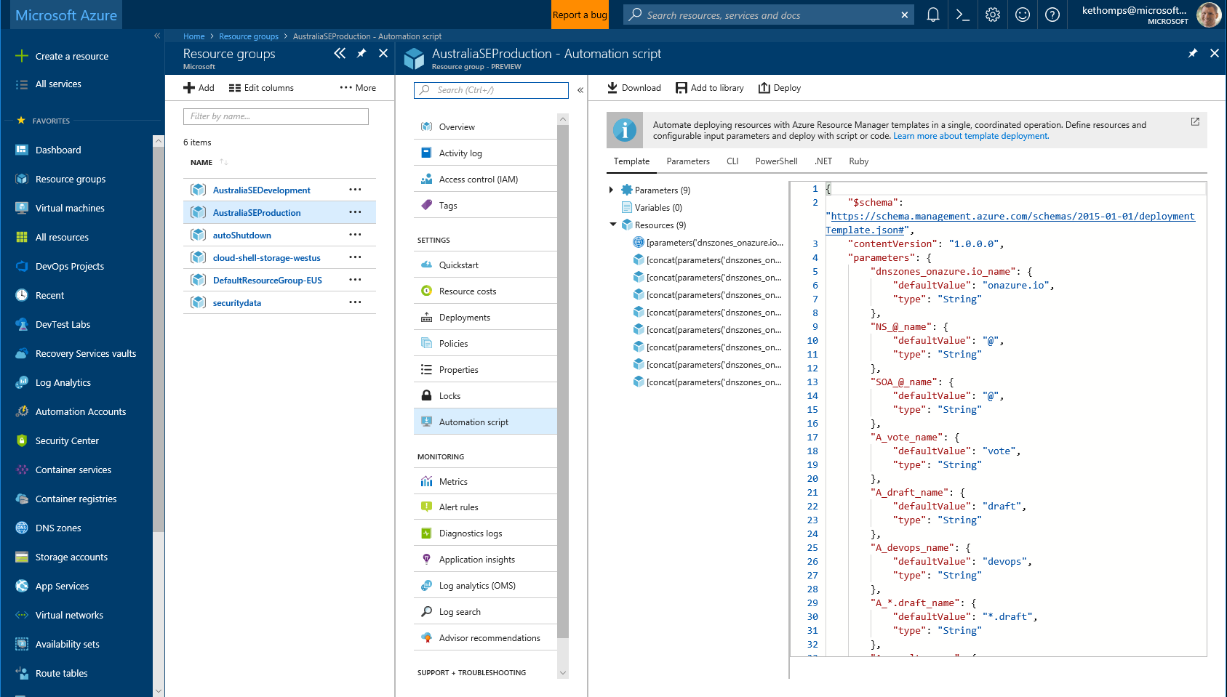
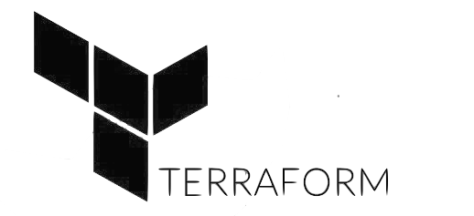


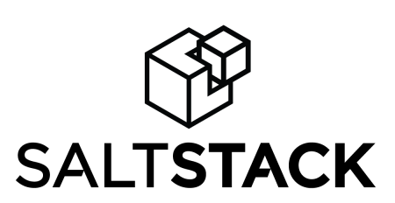

Infrastructure and Configuration as Code
Azure Resource Manager, Automation & 3rd Party Integrations
Infrastructure as Code, built-in
Azure Config & Automation
Support for 3rd party and OSS tooling such as Terraform, Ansible, Chef, Puppet & SaltStack
Notes:
Deploy repeatedly & reliably using Infrastructure as Code
Azure Resource Manager provides these capabilities for Azure out of the box, and works across Azure as well as Azure Stack
But if you’re already using 3rd party tools such as Terraform, Ansible, Chef, Puppet or SaltStack – we support those too!

Slide 25
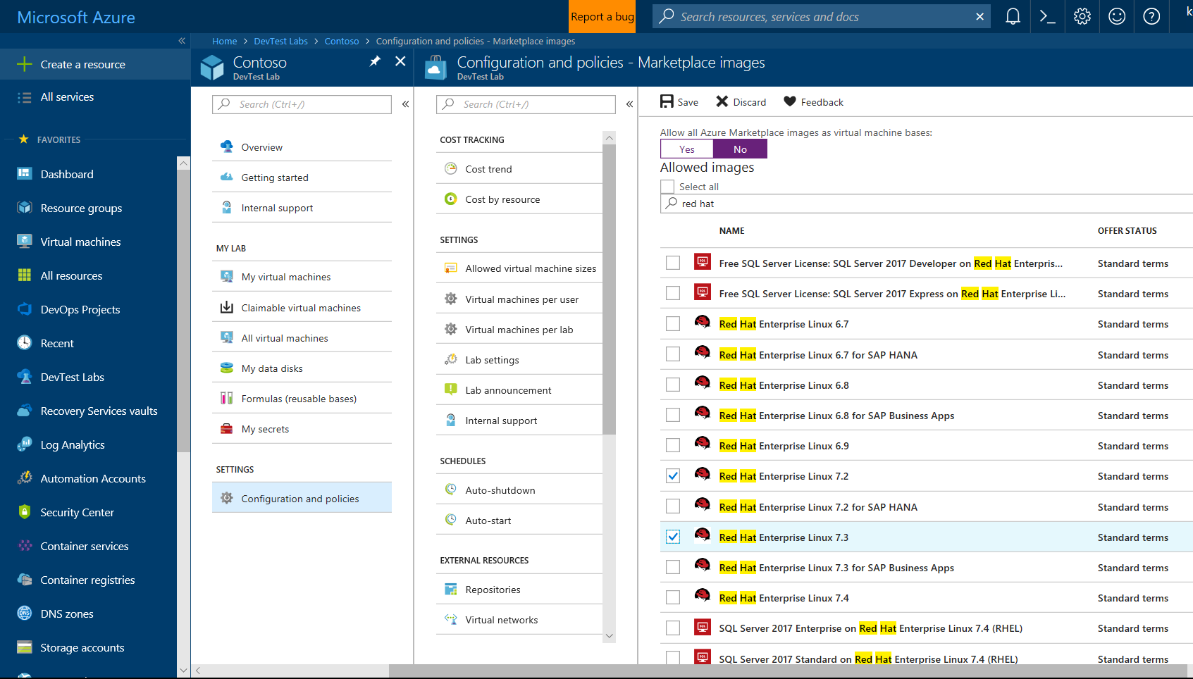
Self-Service Dev/Test Environments
Azure Lab Services
Simplify cloud environment management for developers and testers.
Enforce policies and control costs with full visibility
Use templates, custom images and formulas to reproduce environments.
Orchestrate with Azure Pipelines or integrate using REST API
Notes:
Whether you’ve already started implementing DevOps or looking to get started, a common challenge is for IT organizations is keeping up with project demand for development and test environments
DevTest Labs simplifies environment management for Dev & Test environments in the Azure cloud
Provide self-service access for teams, with policies to control cost and enforce use of appropriate images and artifacts

Slide 26
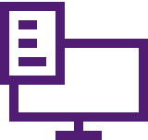
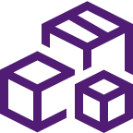



Azure DevOps
Plan smarter, collaborate better, and ship faster with a set of modern dev services
Any developer, any platform, any cloud. Full support for hybrid cloud, on-premises & containers.
Use all the Azure DevOps services or choose just what you need to complement your existing workflows
Best in class builds for open source. Free unlimited build minutes for public projects and up to 10 free concurrent jobs across Windows, Linux and macOS
Get started for free for small teams, scales to support the largest enterprises
Azure Boards
Azure Repos
Azure Pipelines
Azure Test Plans
Azure Artifacts
Start free today
➔
https://azure.com/devops

Slide 27

Thank you!
Martin Woodward
martinwo@microsoft.com
@martinwoodward

